Slide 1


Computer Applications to Behavioral Sciences
Lecture 6. String
何吉波，博士
清华大学用户体验学科负责人
优视眼动科技公司创始人
http://www.usee.tech

Slide 2
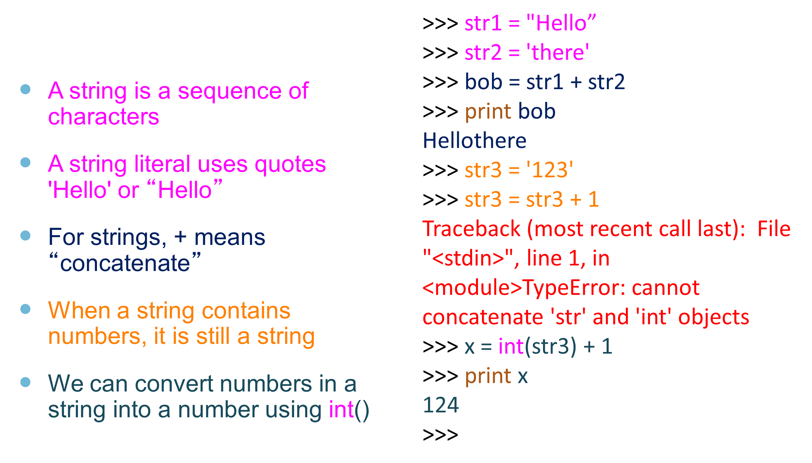
String Data Type

Slide 3
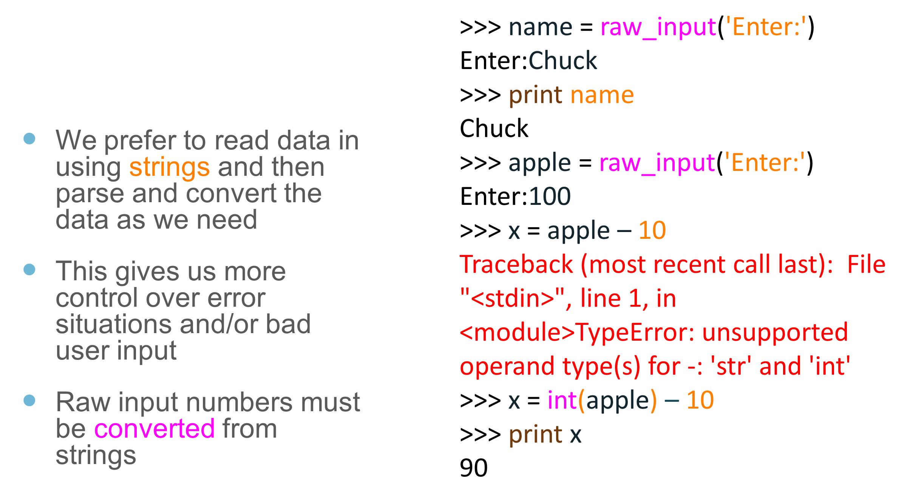
Reading and Converting

Slide 4
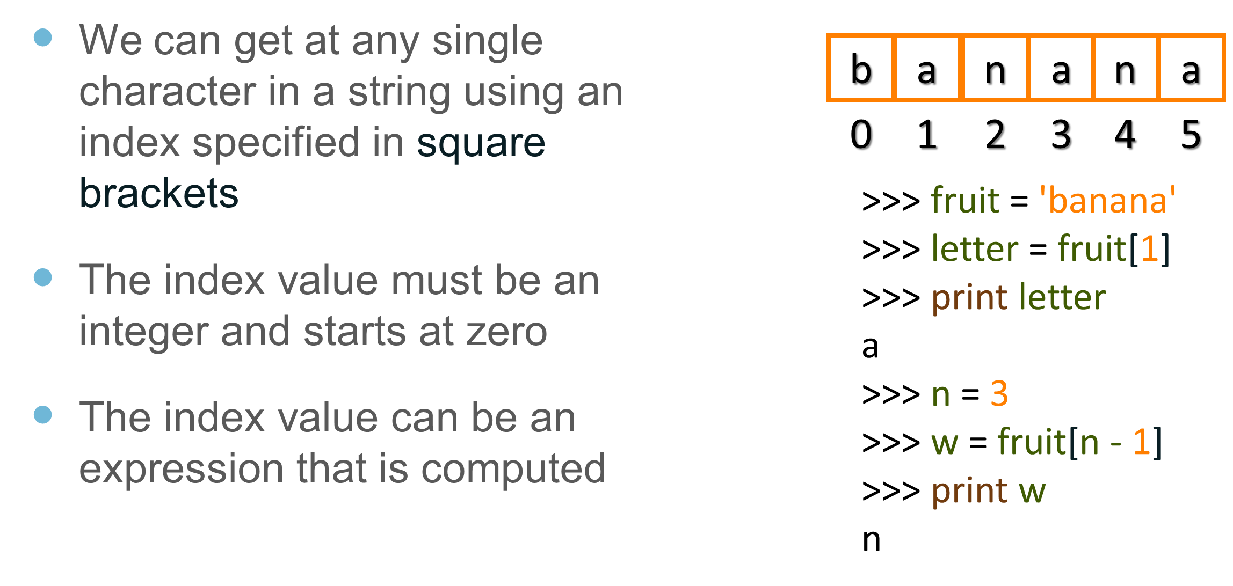
Looking Inside Strings

Slide 5
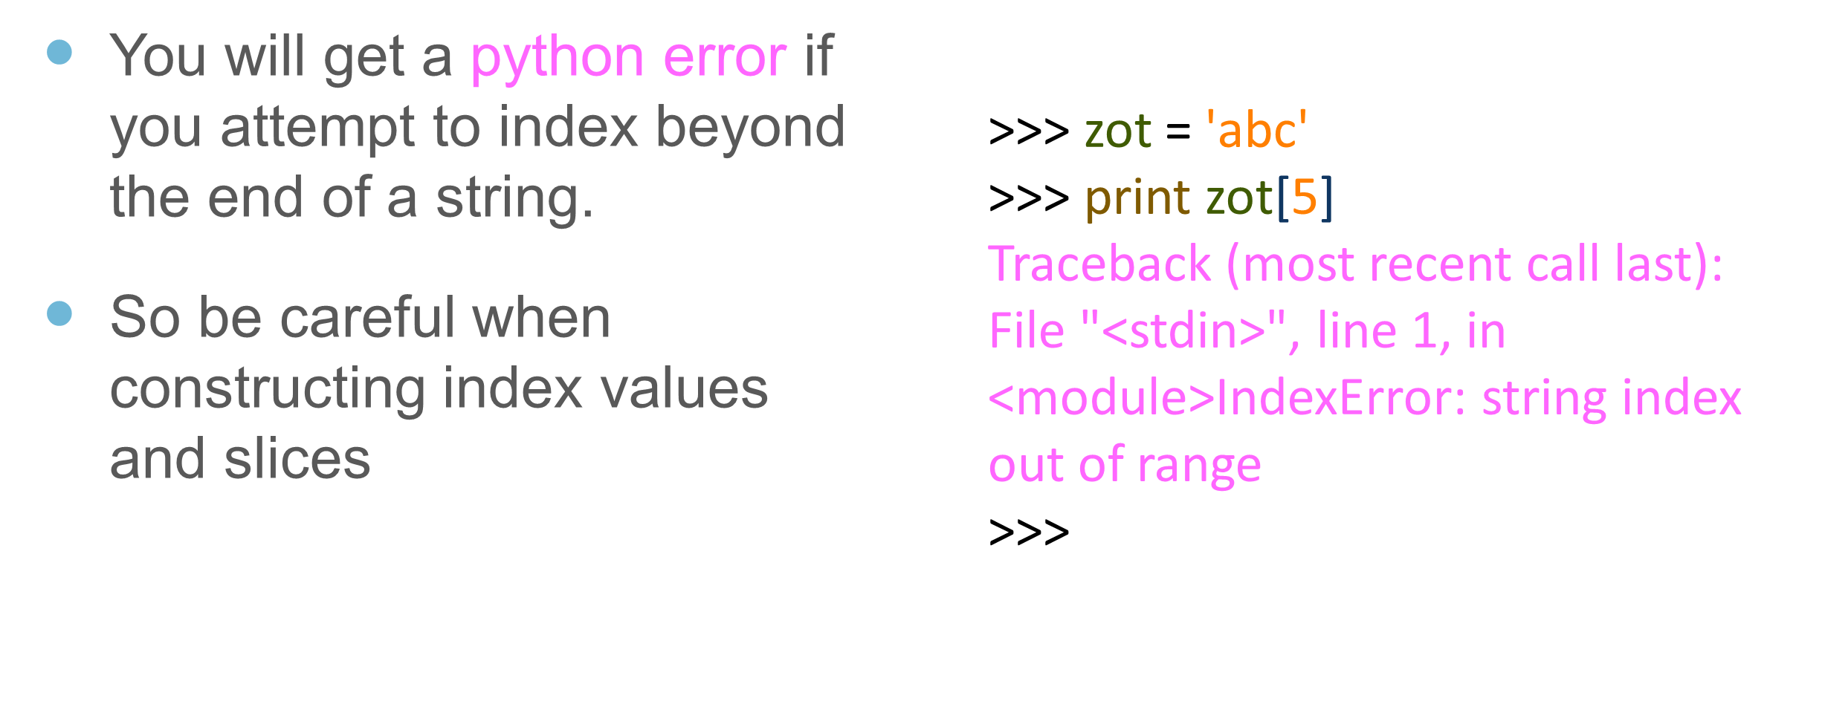
A Character Too Far

Slide 6
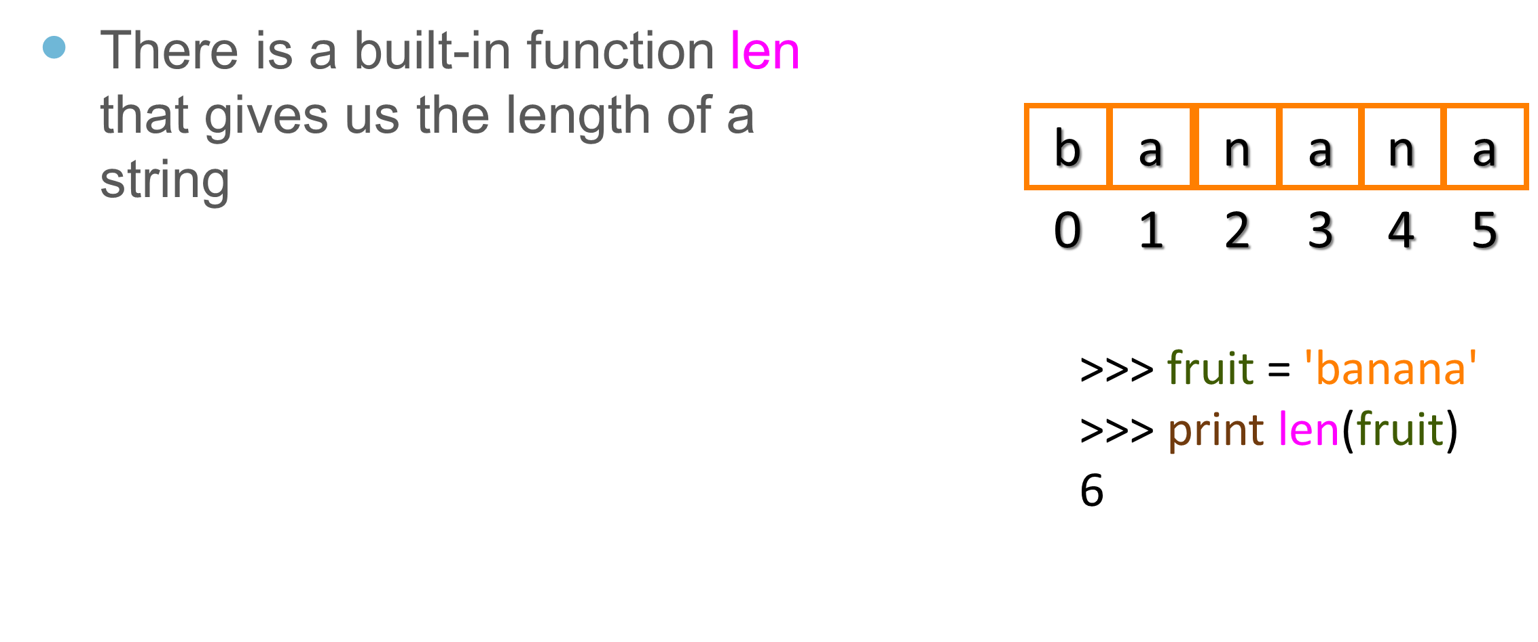
Strings Have Length

Slide 7
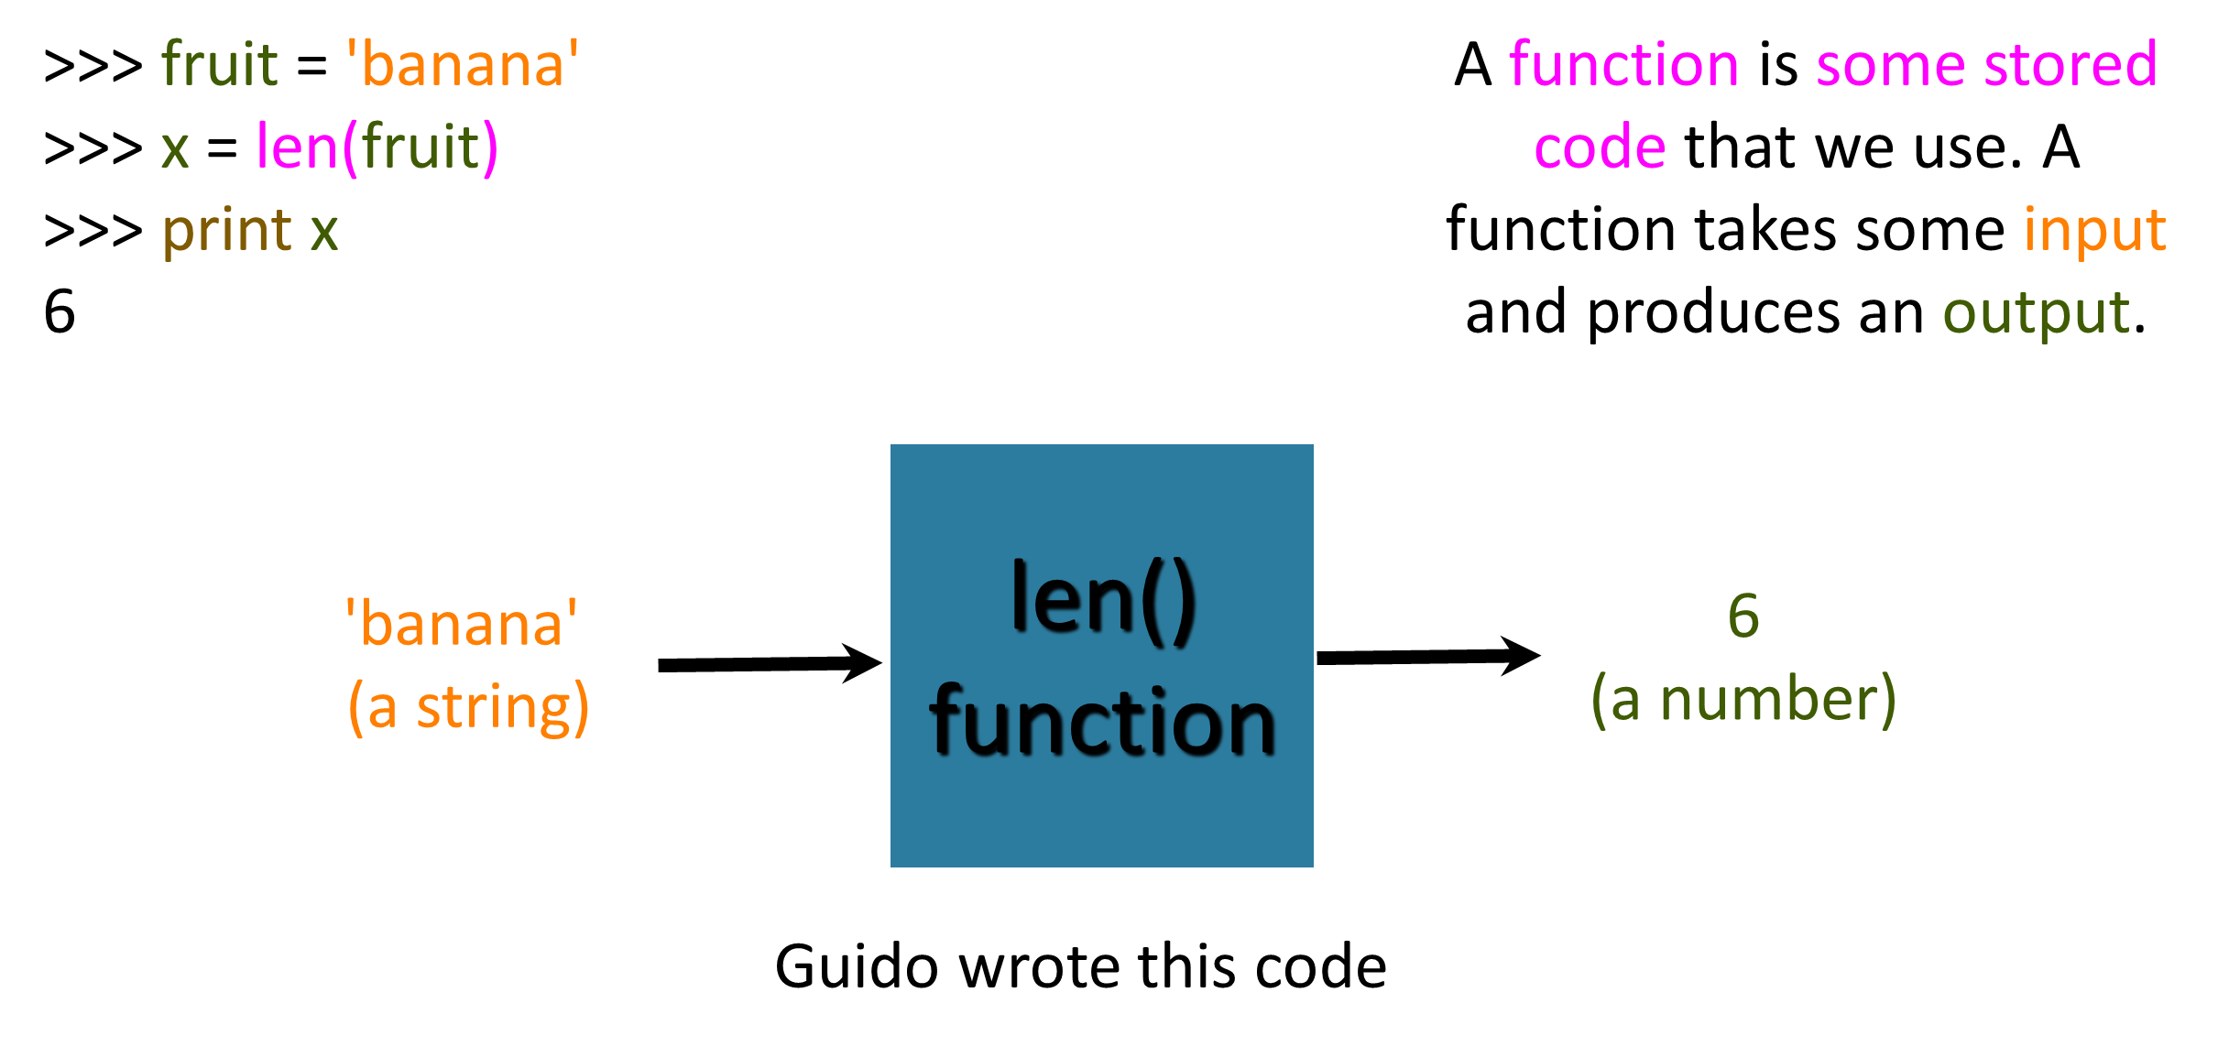
Len Function

Slide 8
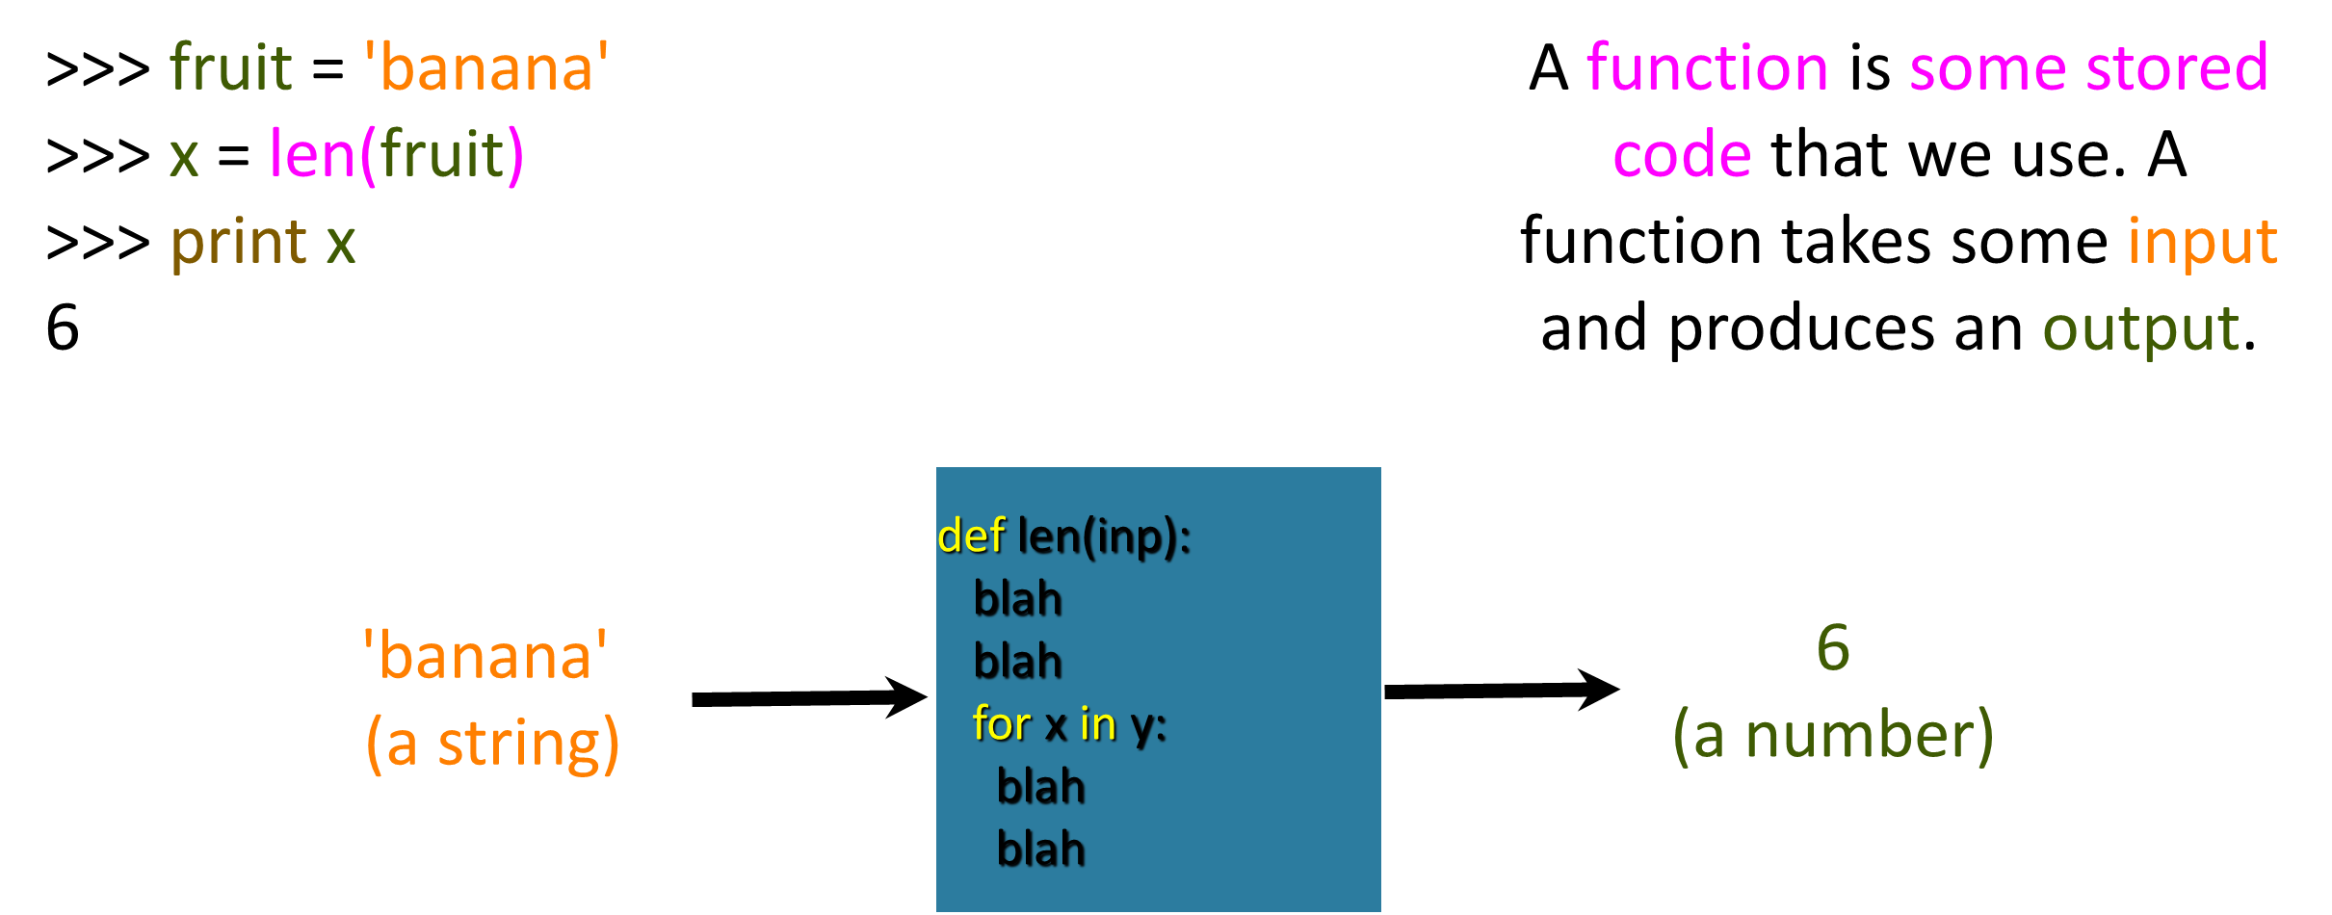
Len Function

Slide 9
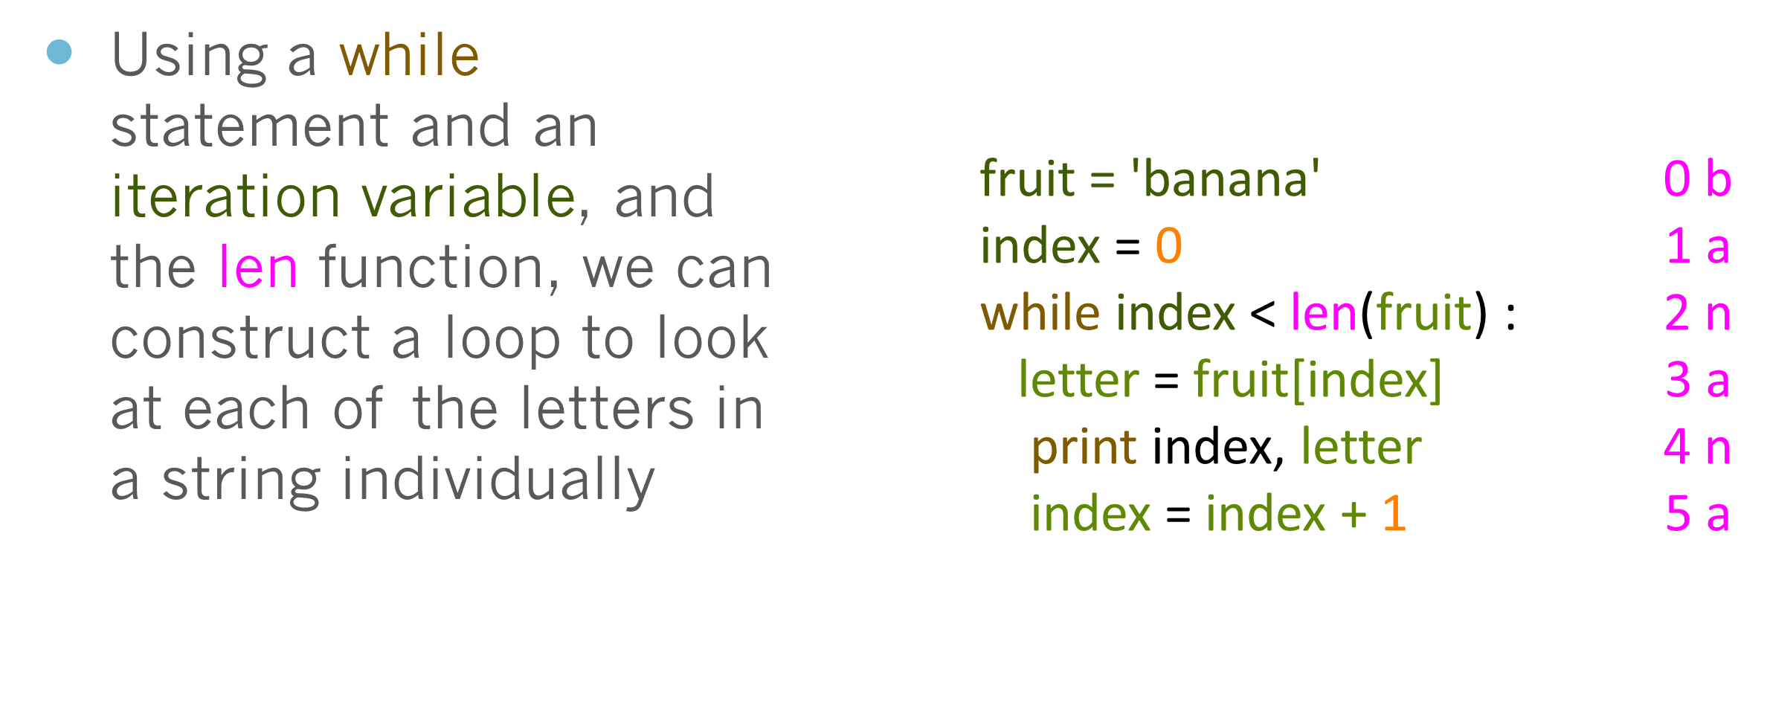
Looping Through Strings

Slide 10
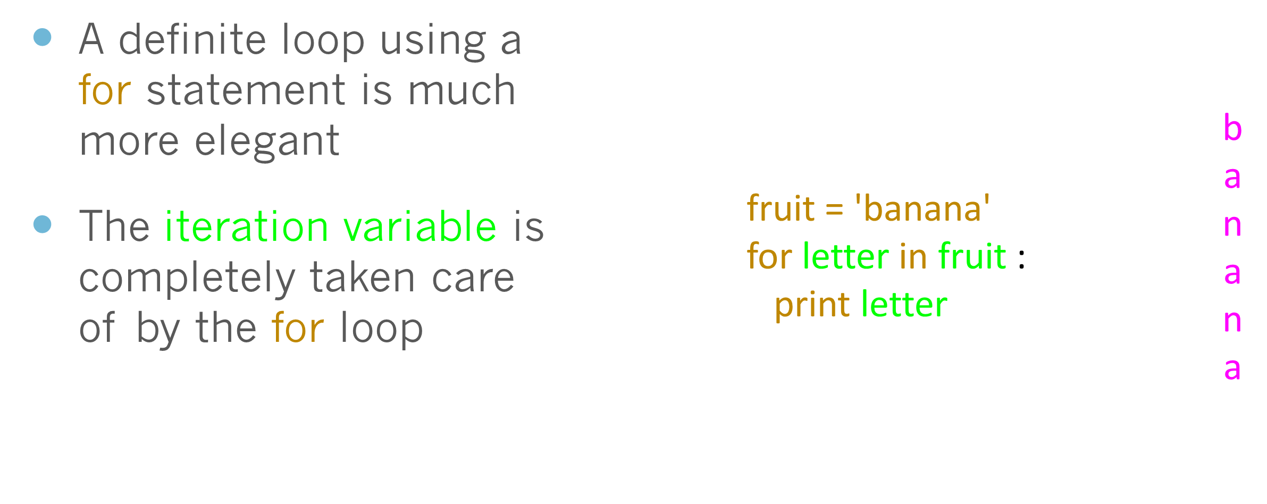
Looping Through Strings

Slide 11
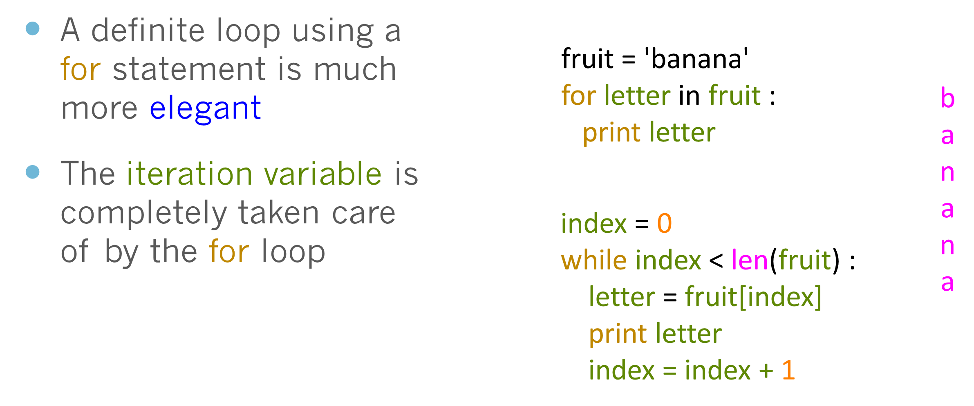
Looping Through Strings

Slide 12
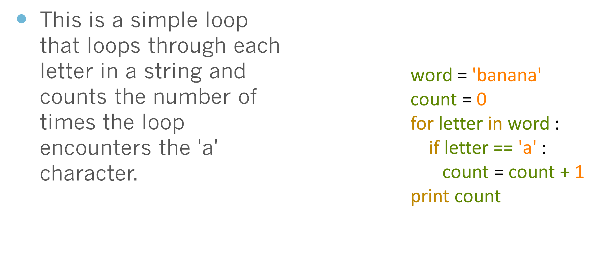
Looping and Counting

Slide 13
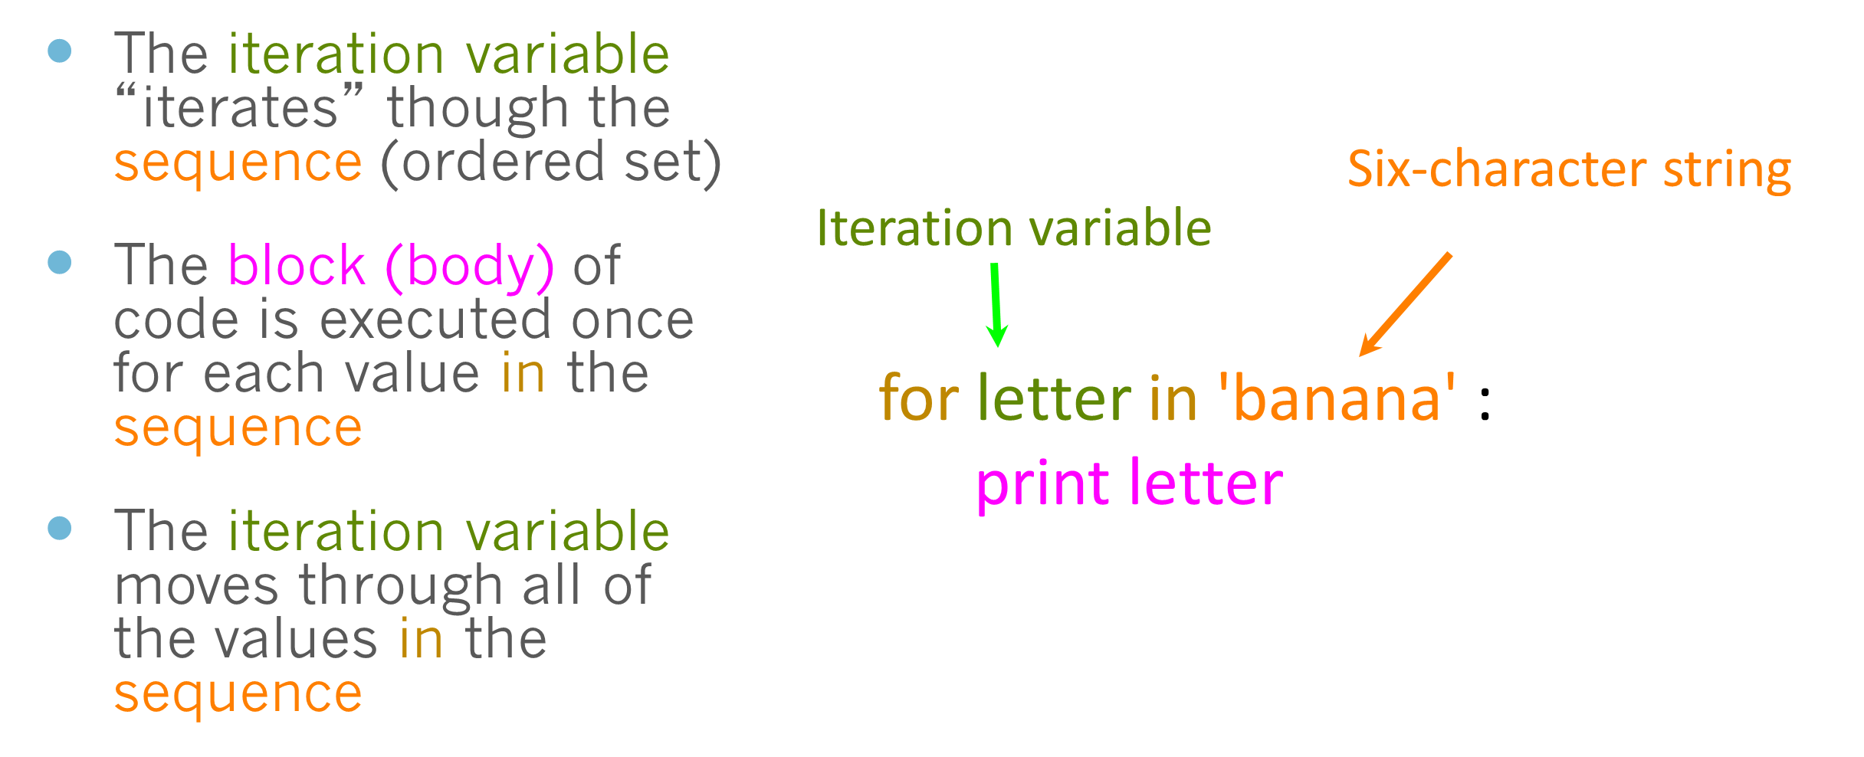
Looking deeper into in

Slide 14
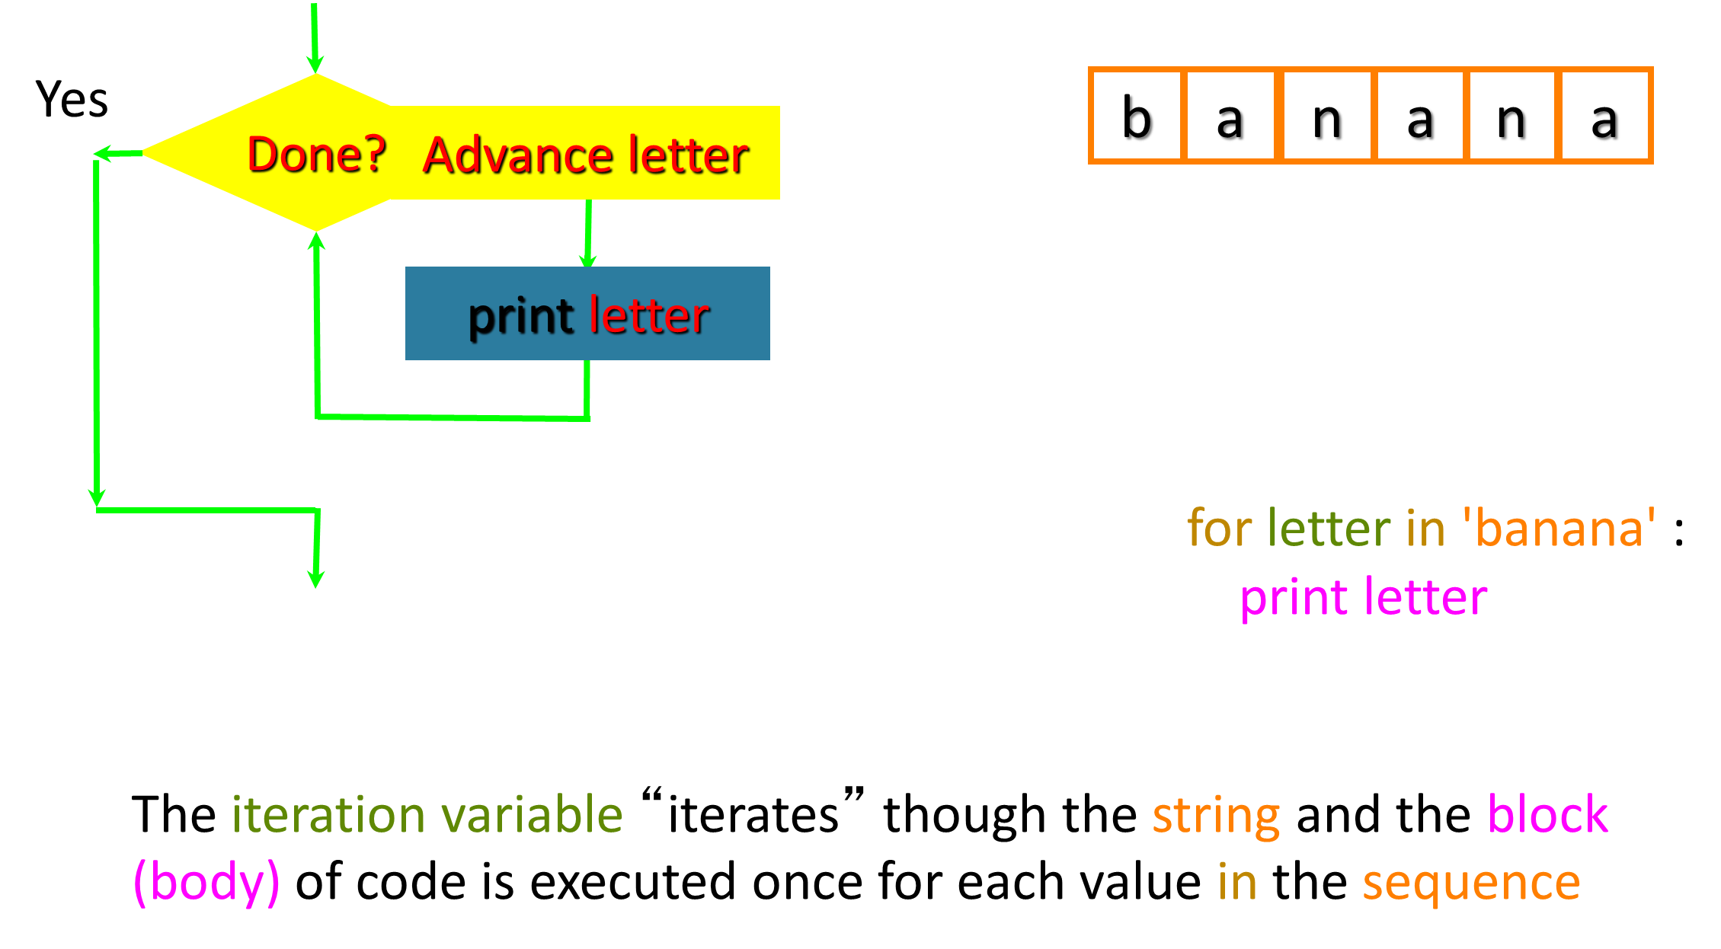

Slide 15
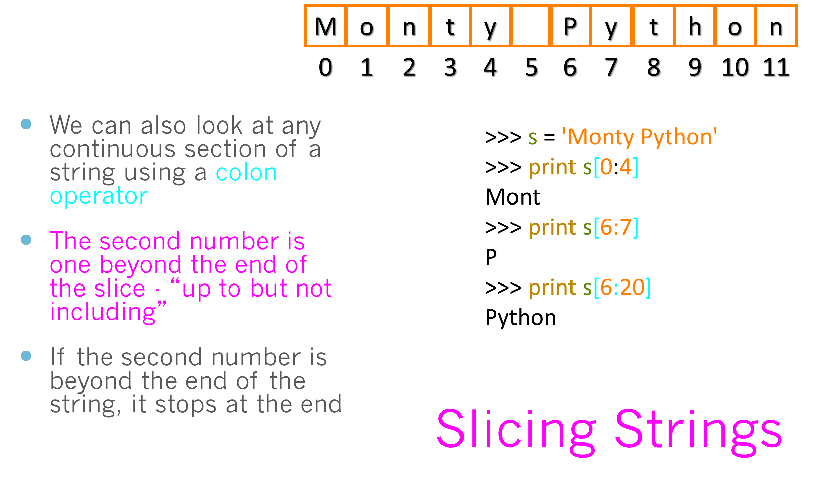

Slide 16
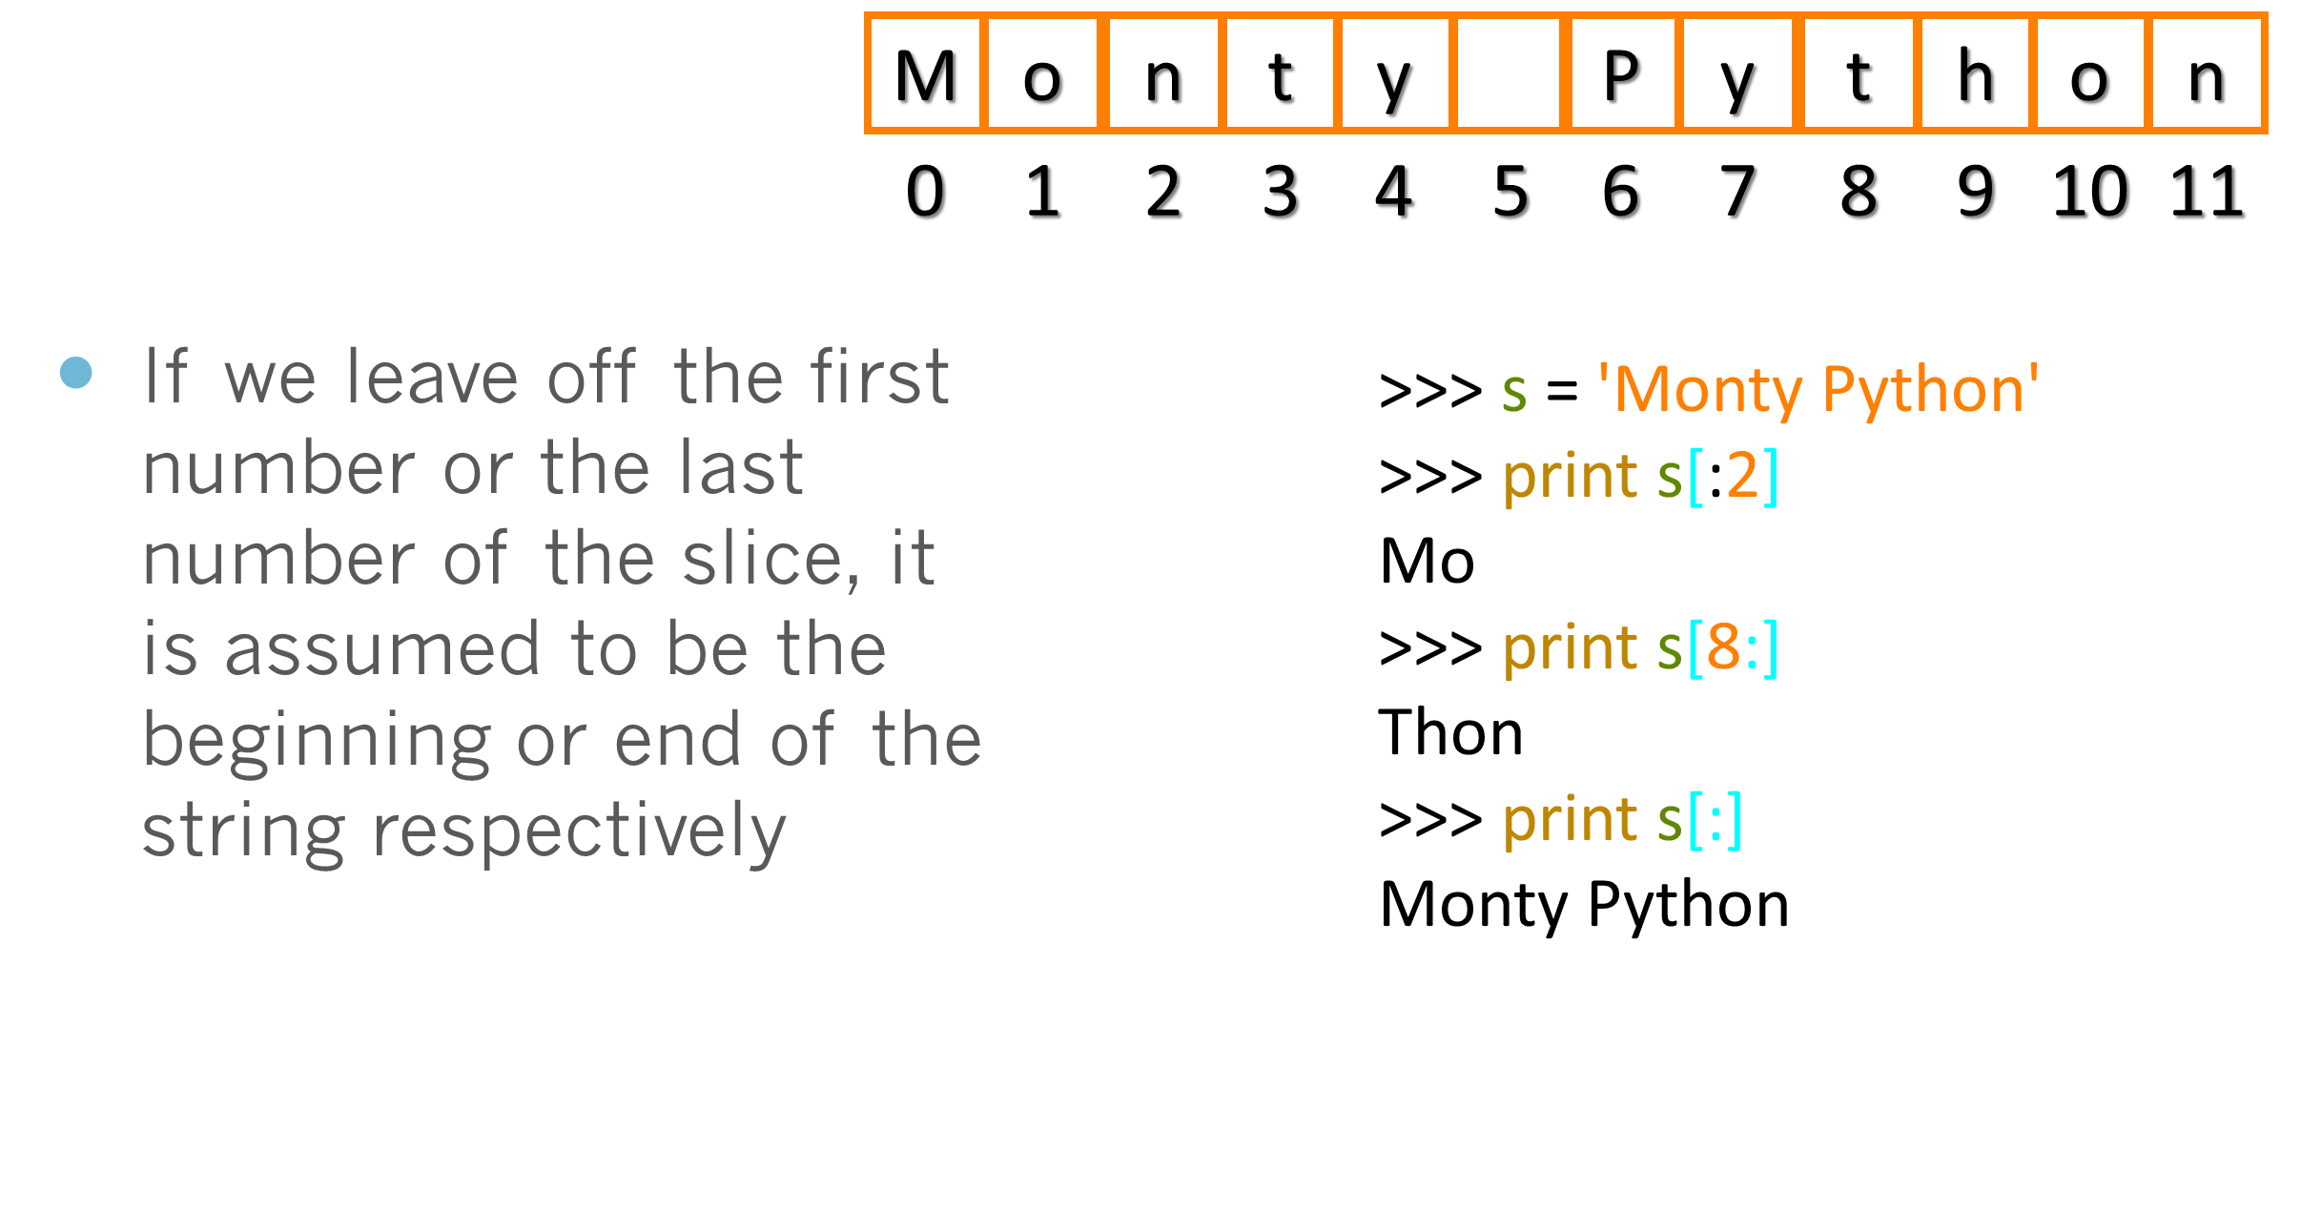
Slicing Strings

Slide 17
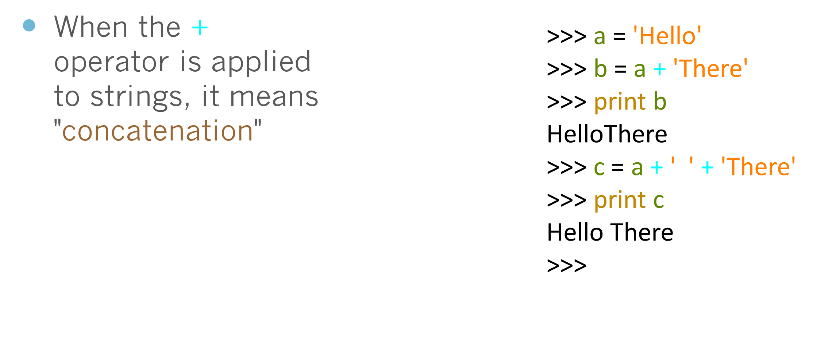
String Concatenation

Slide 18
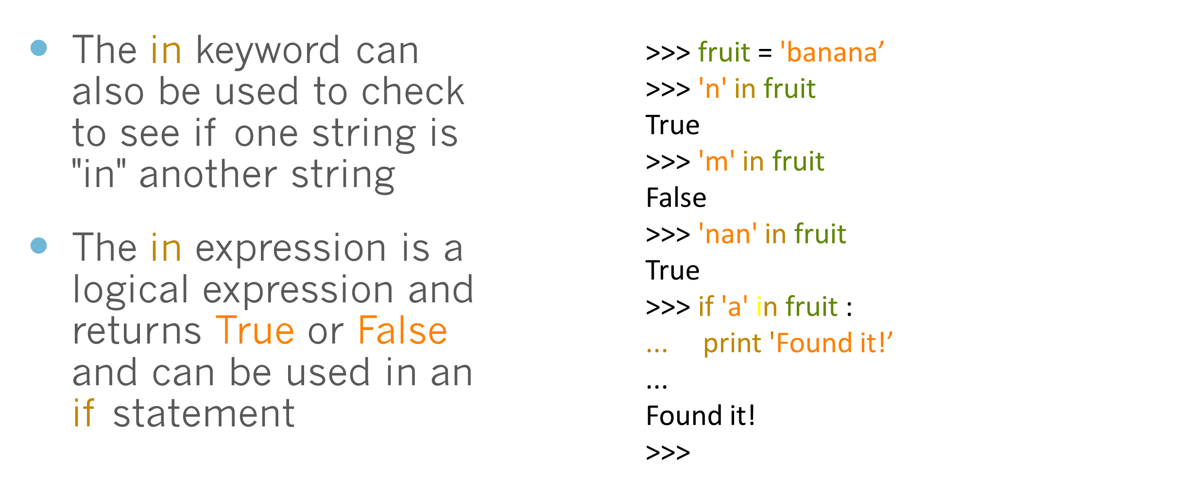
Using in as an Operator

Slide 19
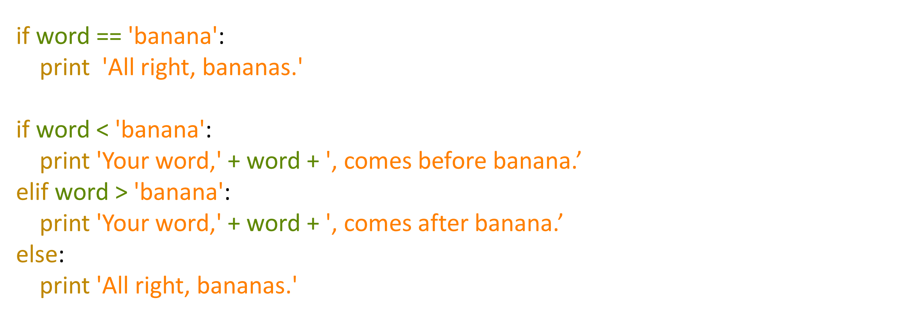
String Concatenation

Slide 20
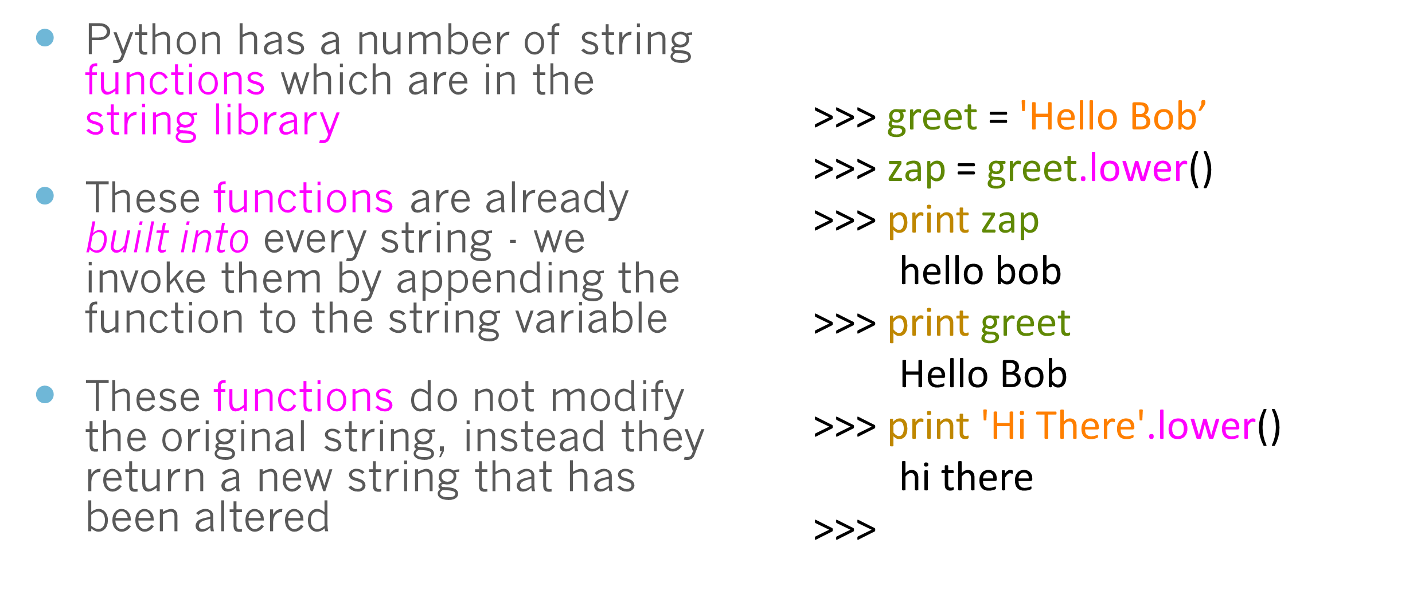
String Library

Slide 21
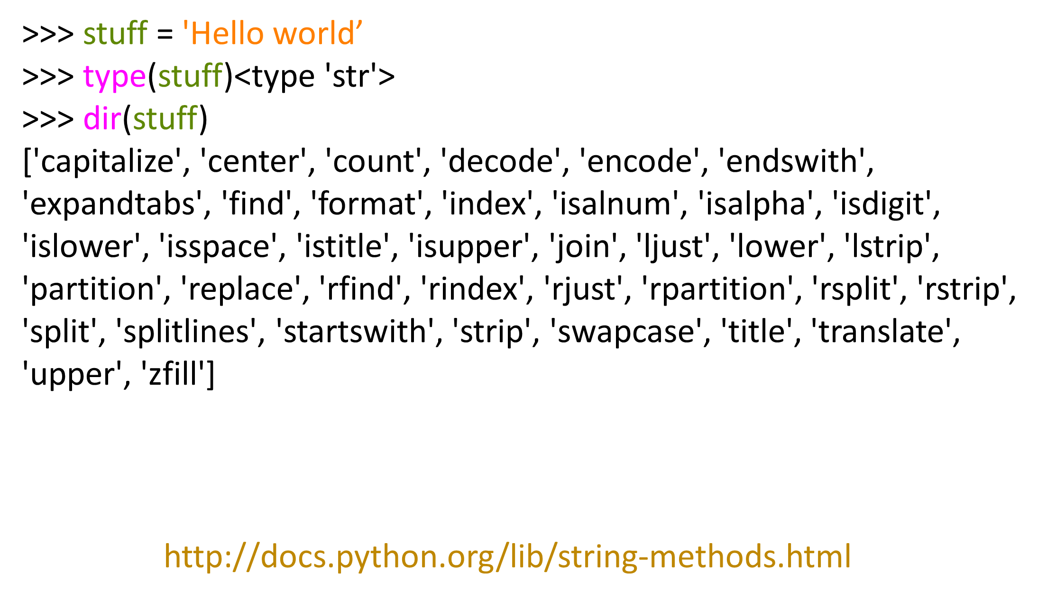
String Concatenation

Slide 22
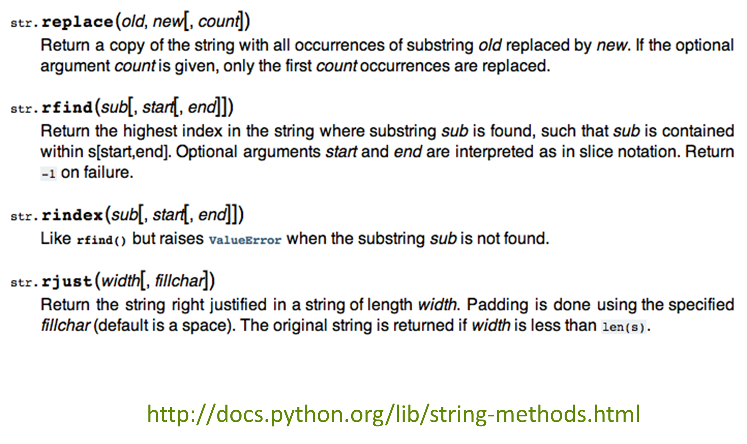

Slide 23
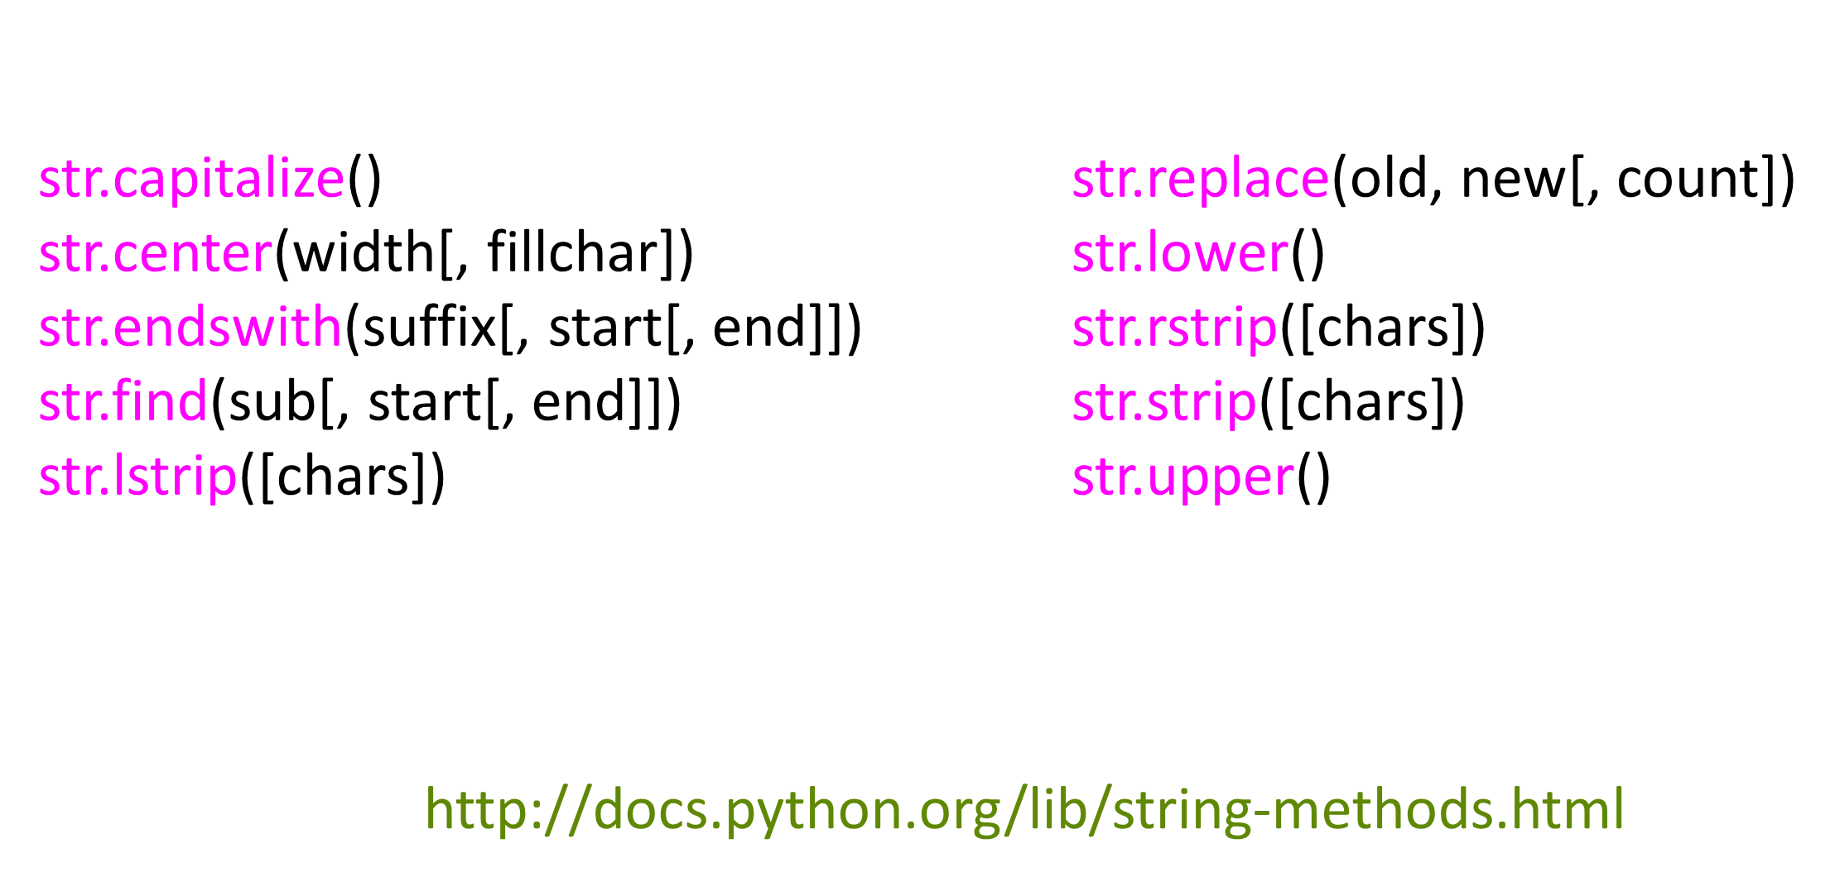
String Library

Slide 24
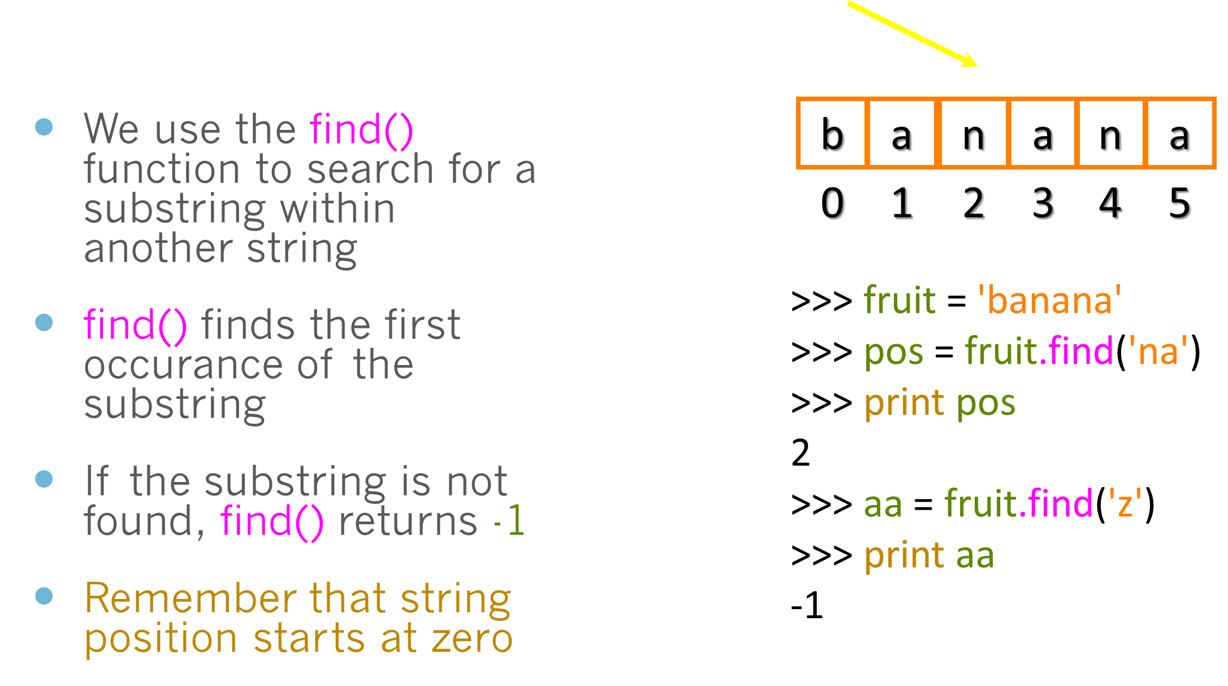
Searching a String

Slide 25
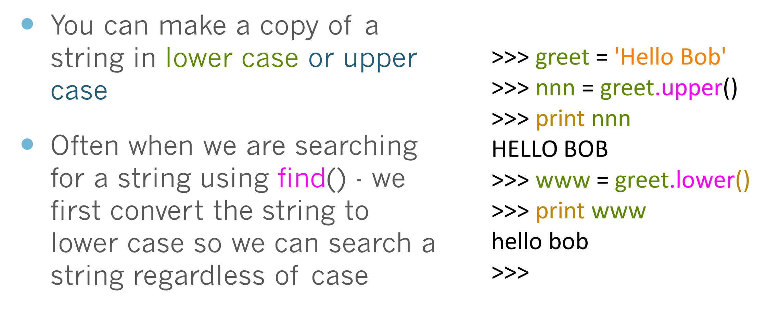
Making everything UPPER CASE

Slide 26
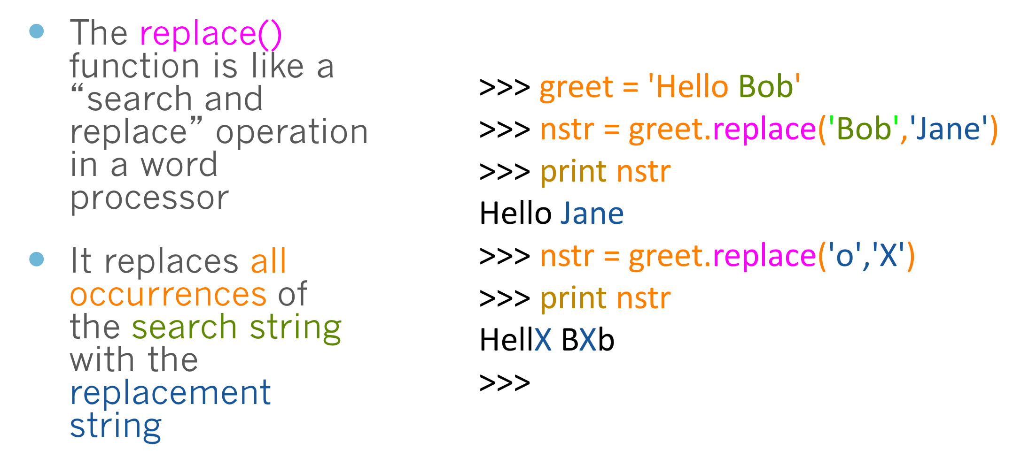
Search and Replace

Slide 27
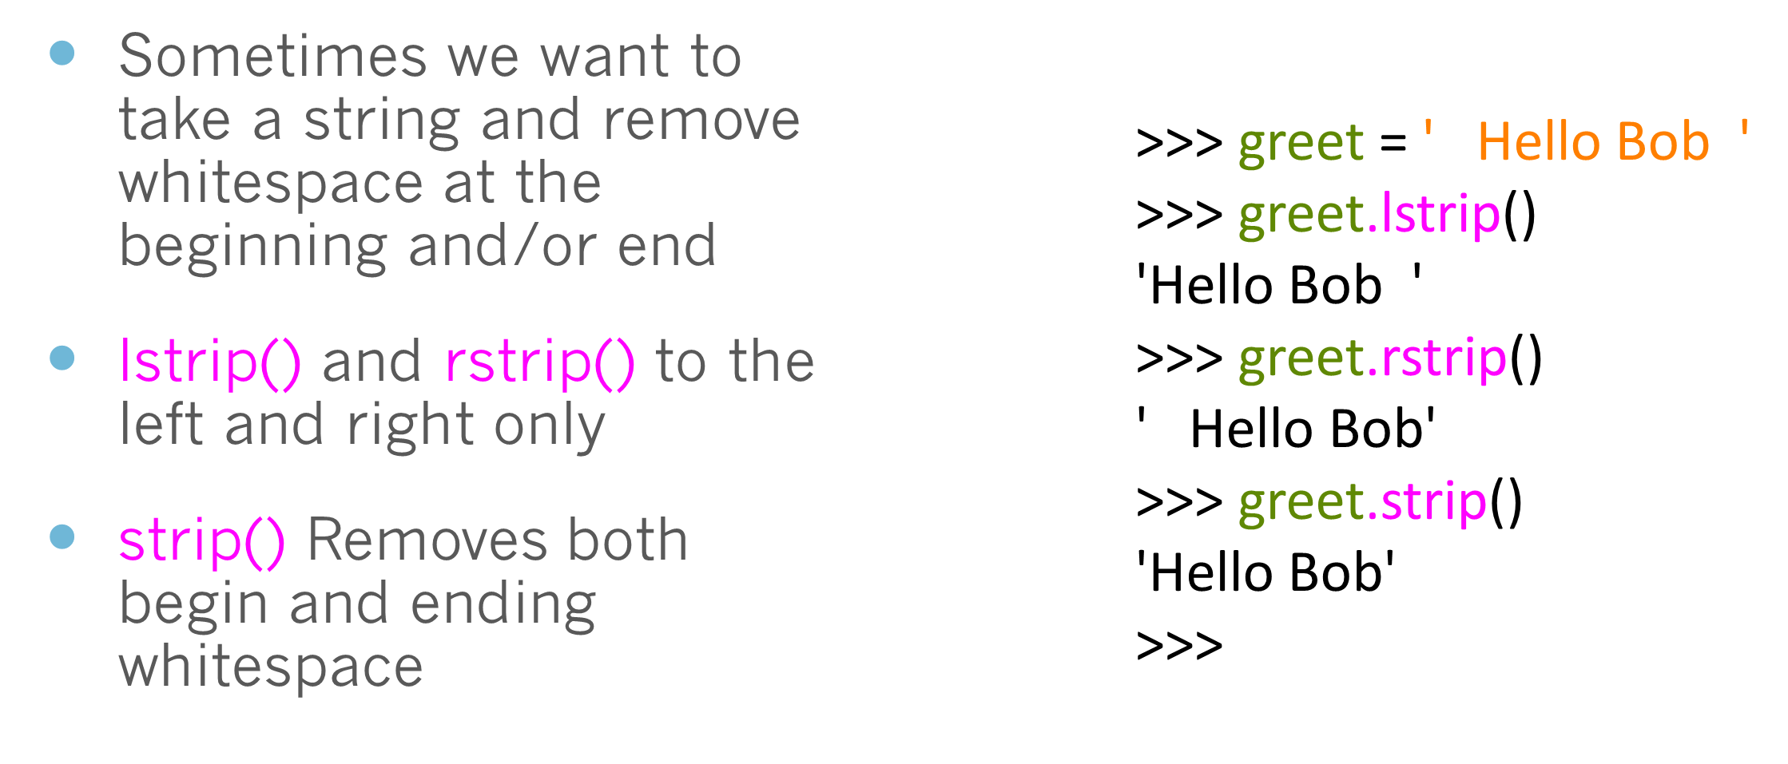
Stripping Whitespace

Slide 28
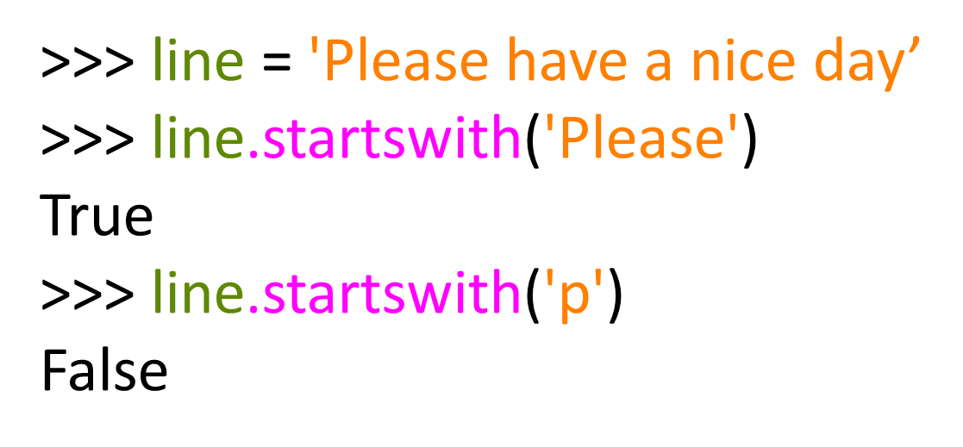
Prefixes

Slide 29
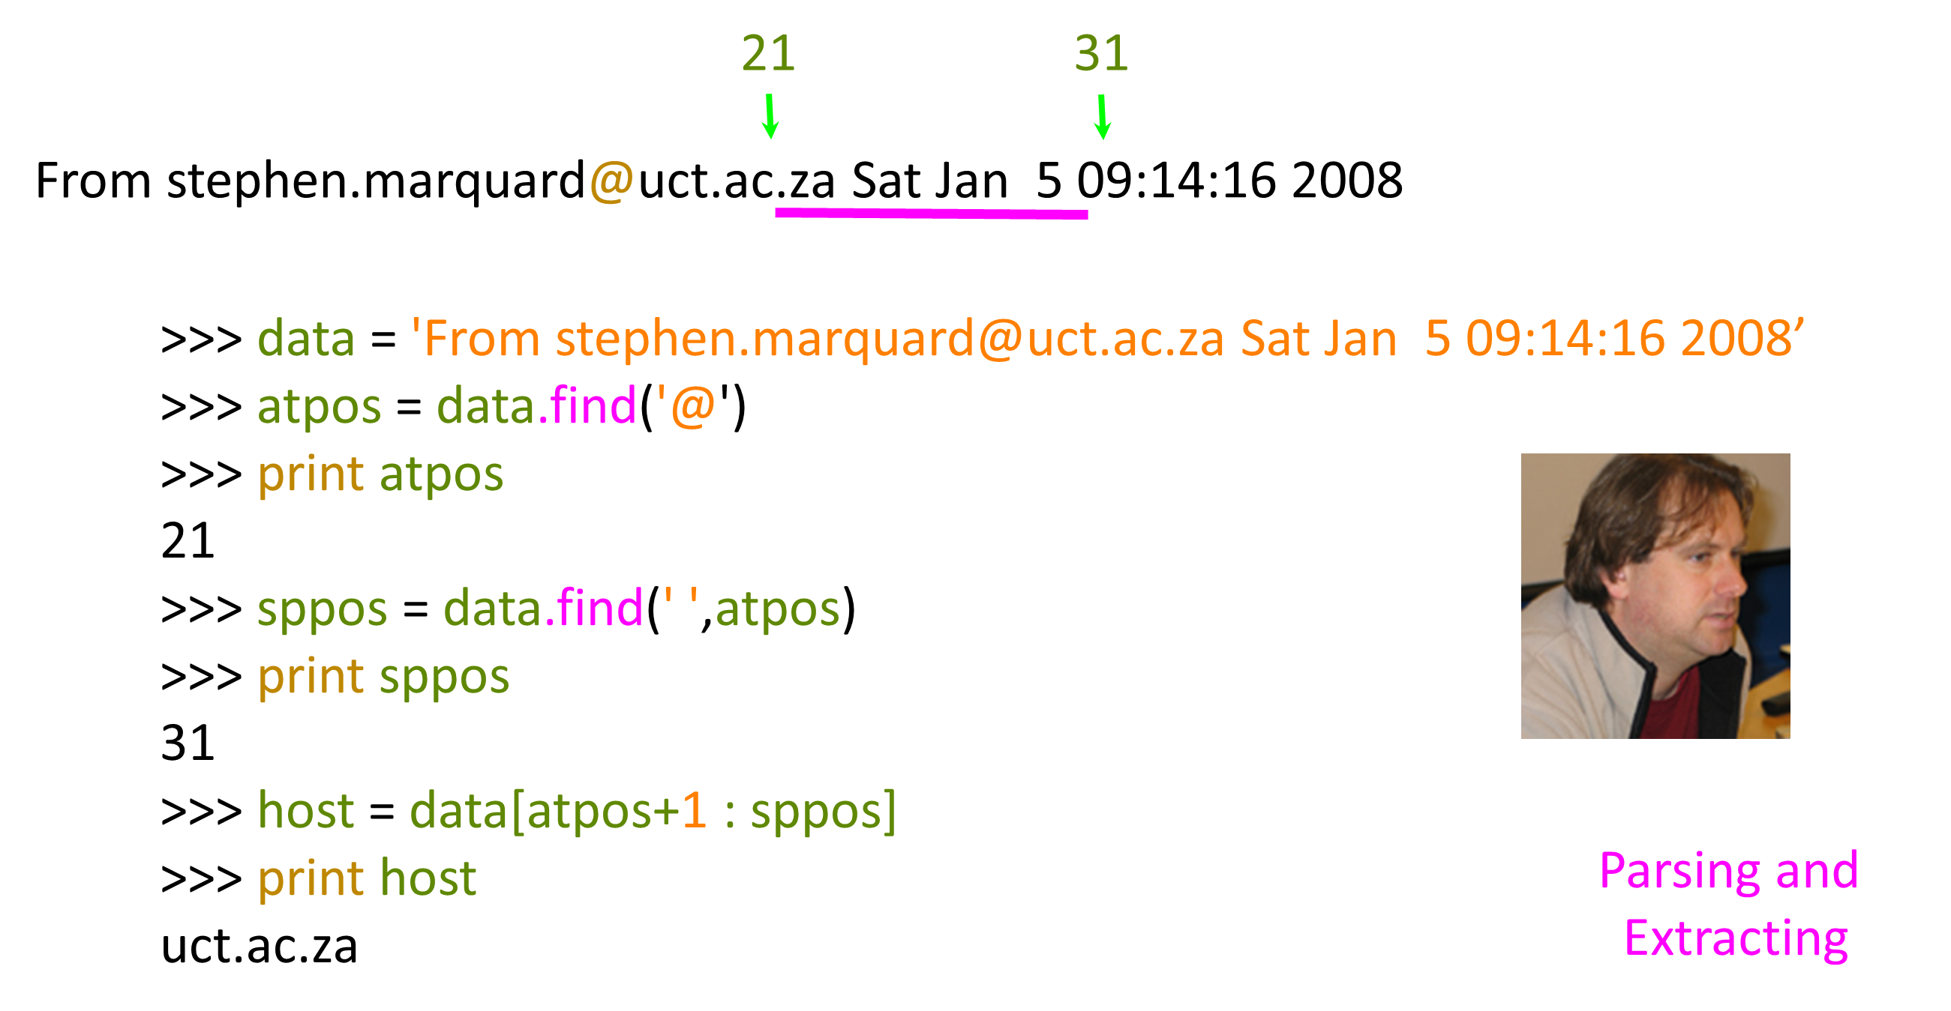

Slide 30
Exercise: Parse file path
Extract the condition, subject id, root folder, filename , and file extension for the following data file.
filename='/Users/hejibo/Dropbox/Barb & Jibo/mobile usability - auto quote system- state farm vs. geico/Subject Data/s06f37state/activityLog-06-27-16-09-04-s06f37state.txt”
ParseFilePath.py

Slide 31
Exercise: Parse file path
filename='/Users/hejibo/Dropbox/Barb & Jibo/mobile usability
- auto quote system- state farm vs. geico/Subject Data/s06f37state/
activityLog-06-27-16-09-04-s06f37state.txt”
conditionidentifier = filename[-15:-4]
print(conditionidentifier)
condition = conditionidentifier[-5:]
print(condition)
subject = int(conditionidentifier[1:3])
print(subject)
lastslash=filename.rfind("/")
rootfolder = filename[:lastslash+1]
print(rootfolder)
filenameOnly = filename[lastslash+1:]
print(filenameOnly)
fileExtension = filename[-3:]
print(fileExtension)
ParseFilePath.py

Slide 32
Summary
String type
Read/Convert
Indexing strings []
Slicing strings [2:4]
Looping through strings with for and while
Concatenating strings with +
String operations

Slide 33
Thank You

